Slide 1
IP Addressing
Caraga State University – Main Campus
College of Computing and Information Sciences
CSC 113 – Data Communications and Networking

Slide 2
Outline
IP Address Overview
Address Classes
Special Addresses
Network Masks

Slide 3

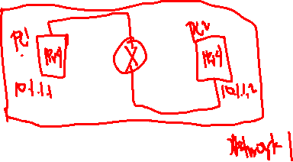
What is an IP Address
Layer 3 logical address assigned by an administrator
Resides at Layer 3 of OSI Model
Used to uniquely identify devices on a network
Every device on the internet has a unique IP address

Slide 4



IPv4 Characteristics
Layer 3 or network layer protocol
Connectionless protocol, in other words there are no session formed when traffic is transmitted
TCP is connection oriented

Slide 5

IPv4 Characteristics (cont . . . )
Packets are treated independently that’s why traffic may take different paths to get to a destination
Routers will route the traffic via different paths based on options such as load balancing, bandwidth, or hop count
Other routing protocols will use their own metrics to determine the best path

Slide 6
IPv4 Characteristics (cont . . . )
IP also only gives best effort delivery of packets, hence, there is no guarantee of packet delivery
Any packet could be misdirected, it could be duplicated or it could be lost in transmission when sent to a destination
TCP/IP has the ability to retransmit packets that go missing
UDP doesn’t retransmit packets if they get dropped

Slide 7
IPv4 Characteristics (cont . . . )
IP has no data recovery features
If the packet, for example, gets corrupted, the end devices need to handle that and not the routers in between
IP has no built-in sessions, no data recovery, and no retransmissions

Slide 8
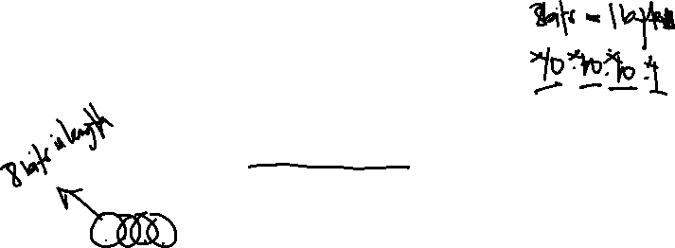
IPv4 Format Overview
IP address is 32 bits in size, normally written in dotted decimal notation
x.x.x.x with each x being eight bits in length, also known as an octet
Has a hierarchical structure to enable routing, which consists of two main parts – network portion and host portion

Slide 9
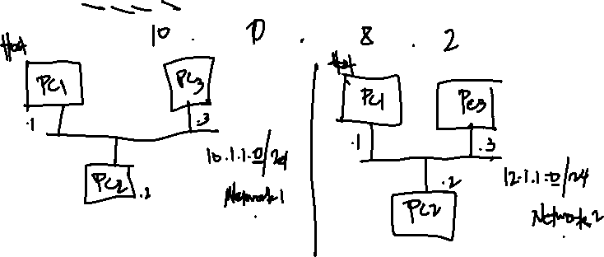
IPv4 Format Overview
Divided into four octets (8 bits or 1 byte)
00001010.00000001.00001000.00000010

Slide 10

Address Classes
Class A
Class B
Class C
Class D
Class E
IPv6 does not use address classes
IPv4 address classes was replaced by CIDR

Slide 11
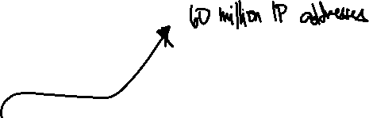
Address Classes
Class A, B, and C were used to accommodate different sizes of networks and aids in classifying networks
Determined by the Internet Assigned Numbers Authority (IANA)

Slide 12
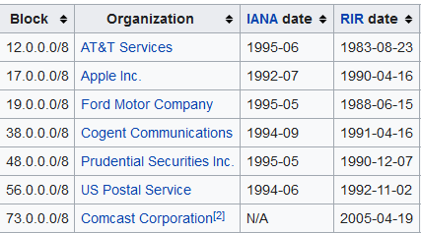
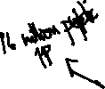
Address Classes (Class A)

Slide 13
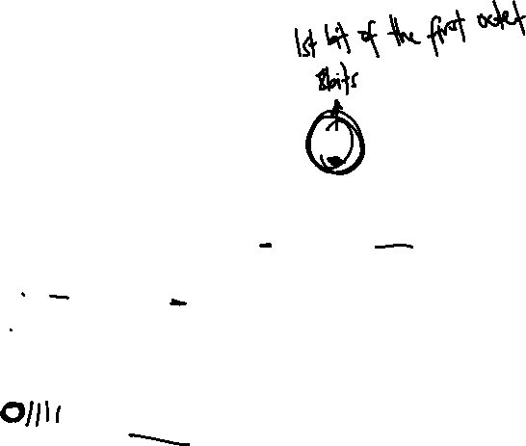
Class A
Starts with a binary 0
The first bit is set to 0
Class A range is from 0.0.0.0 – 127.255.255.255

Slide 14
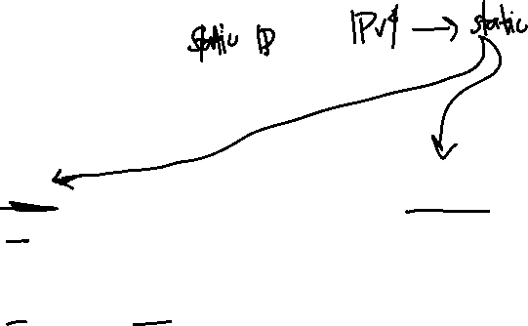
Class A
Exception:
127 is reserved for loopback – 127.0.0.1
0 network is reserved for default network
Actual Range:
1.0.0.0 to 126.255.255.255

Slide 15
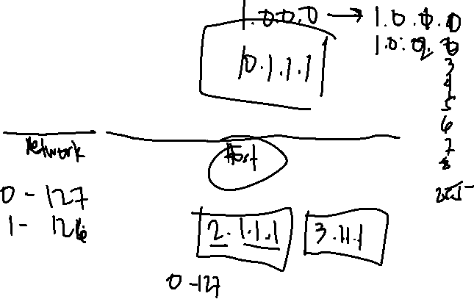
Class A
Network and Host Portions:
00000000.00000000. 00000000. 00000000

Slide 16
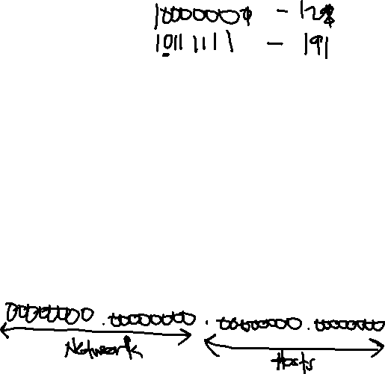
Class B
Starts with binary 10 (one zero)
Consists of a 16-bit network addresses and 16-bit hosts addresses
Class A addresses in the first bit in the first octet sets to 0, on Class B Addresses the second bit position in the first octet is set to 0
Therefore, the Class B Addresses are in range from 128 – 191 in the first octet

Slide 17
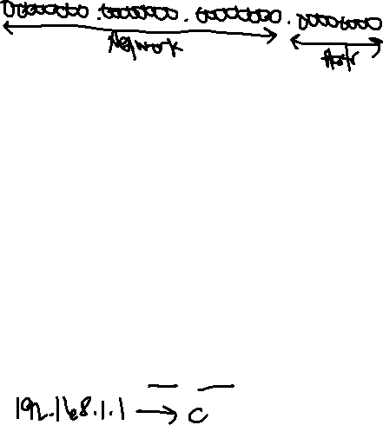
Class C
Starts with binary 110 (one one zero)
Consists of a 24-bit network addresses and 8-bit hosts addresses
The first three bits in the network address indicate the network class
Therefore, there are 2,097,152 possible network addresses and 255 possible local host addresses and the first octet has a range from 192-223

Slide 18
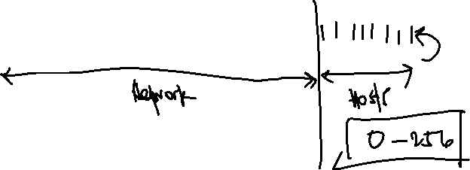
Class C
Network and Host Portion
00000000.00000000.00000000.00000000

Slide 19
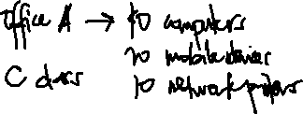
Address Classes
When deciding which network address class to use, you must consider how many local hosts there will be on the network and how many subnetworks will be in the organization.
If the organization is small and the network will have fewer than 255 hosts, a Class C address is probably sufficient.
If the organization is large, then a Class B or Class A address might be more appropriate.

Slide 20
Class D
Multicast, starts with a binary 1110
Fourth bit is set to 0
Range from 224 – 239 (239.1.1.1 - private multicast address)
Routing protocol such as OSPF uses multicast address (224.0.0.5 and 224.0.0.6)

Slide 21
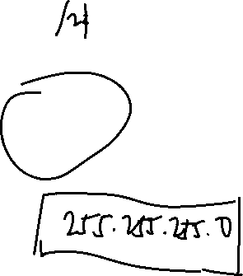
Class E
Reserved address for broadcast
starts with a binary 1111
Range from 224 – 255

Slide 22
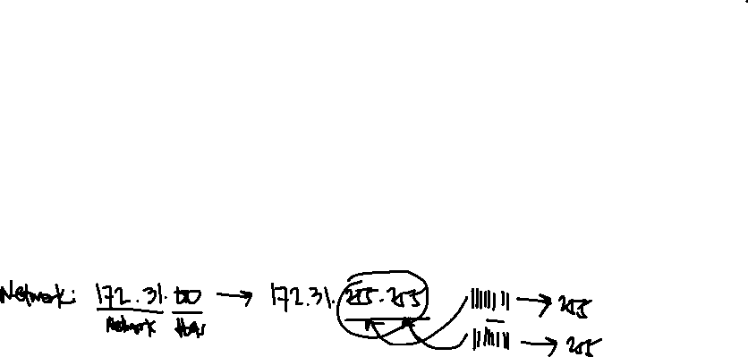
Directed Broadcast Address
Used by hosts to send data to all devices on the specific subnet or specific network
The entire host portion of the address is populated with binary 1’s

Slide 23

Directed Broadcast Address
Routers can be configured to route directed broadcasts, but by default, directed broadcast are not routed from one physical interface to another physical interface or from one VLAN to another VLAN

Slide 24

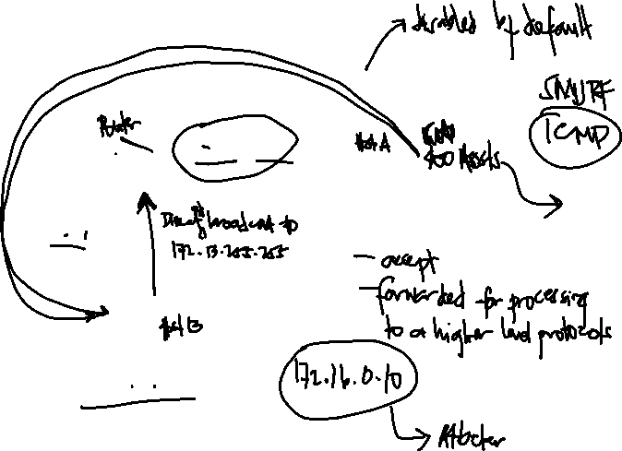



Directed Broadcast Address

Slide 25
Local Broadcast Address
Used to communicate with all devices on the Local Network
The address is populated with binary 1’s (255.2555.255.255)
This address is used by a host when requesting an IP Address from the DHCP server

Slide 26
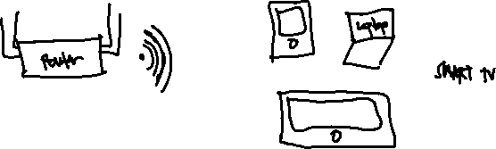
Local Broadcast Address

Slide 27

Local Loopback Address
Used to let a system send a message to itself for testing
This is very useful to make sure that the TCP/IP stack is correctly installed on a machine
Routers have loopback addresses which are not the same as the local loopback address

Slide 28
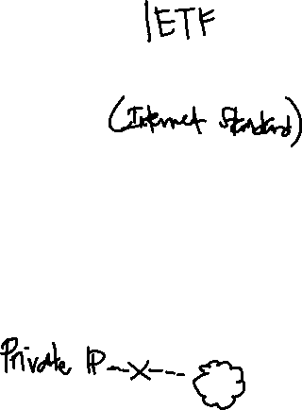
Private Addresses
RFC – Request for Comments
RFC1918 – discusses private IP addresses
Private IP Addresses are non-routable addresses on the internet. These addresses will be blocked by the ISP’s and thus cannot be used for sending traffic unto the internet

Slide 29

Private Addresses
As of the year 2015, the Address Registrar for the Americans has recently run out of IP Addresses, so this RFC (RFC1918) was created to try and increase the longevity of IPv4

Slide 30
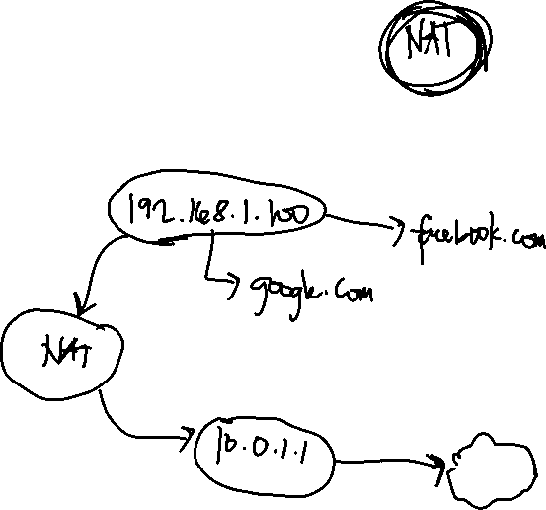
Private Addresses
RFC1918 –non-routable on the Internet

Slide 31
Private Addresses
RFC1918 –non-routable on the Internet
tools.ietf.org/html/rfc1918

Slide 32
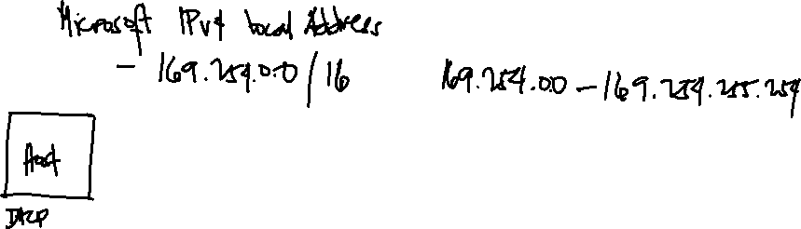
IPv4 Link - Local Addresses
RFC3927 – Automatic Private IP Address (APIPA)

Slide 33
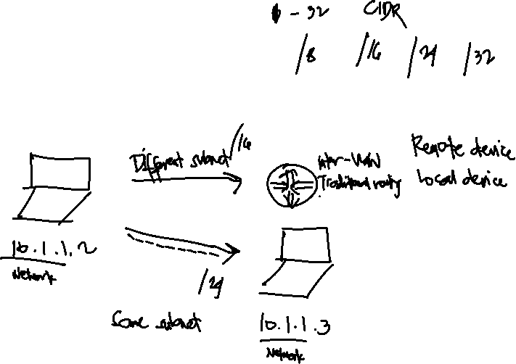
Subnet Mask
Used to determine network and host portion

Slide 34
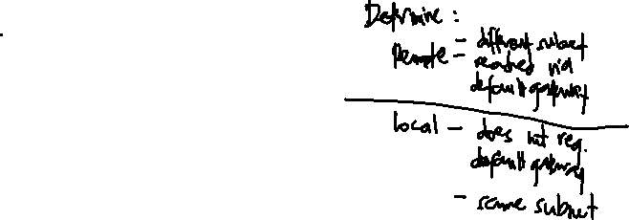
Network Mask
Class A, B, and C networks have default masks, also known as natural masks
Class A: 255.0.0.0
Class B: 255.255.0.0
Class C: 255.255.255.0

Slide 35
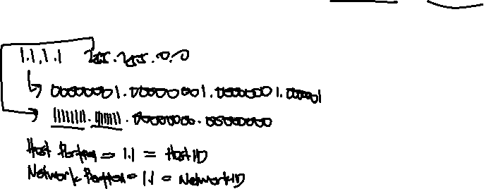
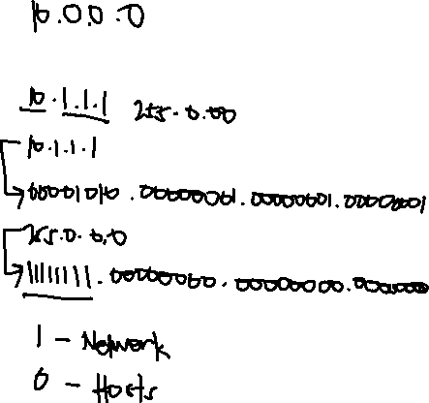
Network Mask
Class A: 255.0.0.0
Class B: 255.255.0.0
Class C: 255.255.255.0

Slide 36
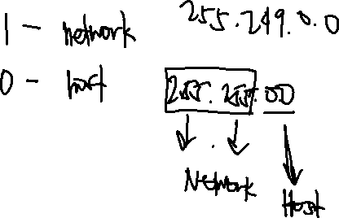
Network Mask
Two Simple Rules:
any address bits which have corresponding mask bit set to 1 represent the Network ID
any address bits that have corresponding mask bits set to 0 represent the Host ID

Slide 37
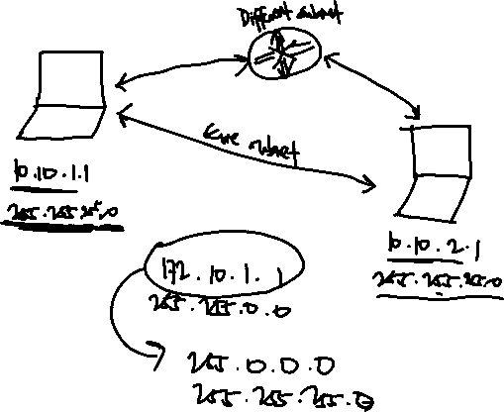
Subnet Mask

Slide 38
Subnet Mask

Slide 39
CIDR (Classless Inter-Domain Routing)
Introduced in 1993
Replaces classful IP Addressing
Variable Length Subnet Mask (VLSM)

Slide 40
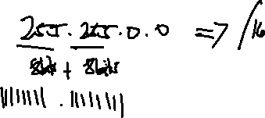
/x mask (CIDR Notation)

Slide 41
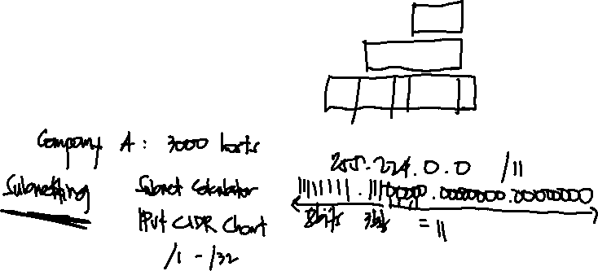
CIDR (Classless Inter-Domain Routing)
Class A: 16,777,214 host addresses – 255.0.0.0
Class B: 65,534 host addresses – 255.255.0.0
Class C: 254 host addresses – 255.255.255.0

